Slide 1
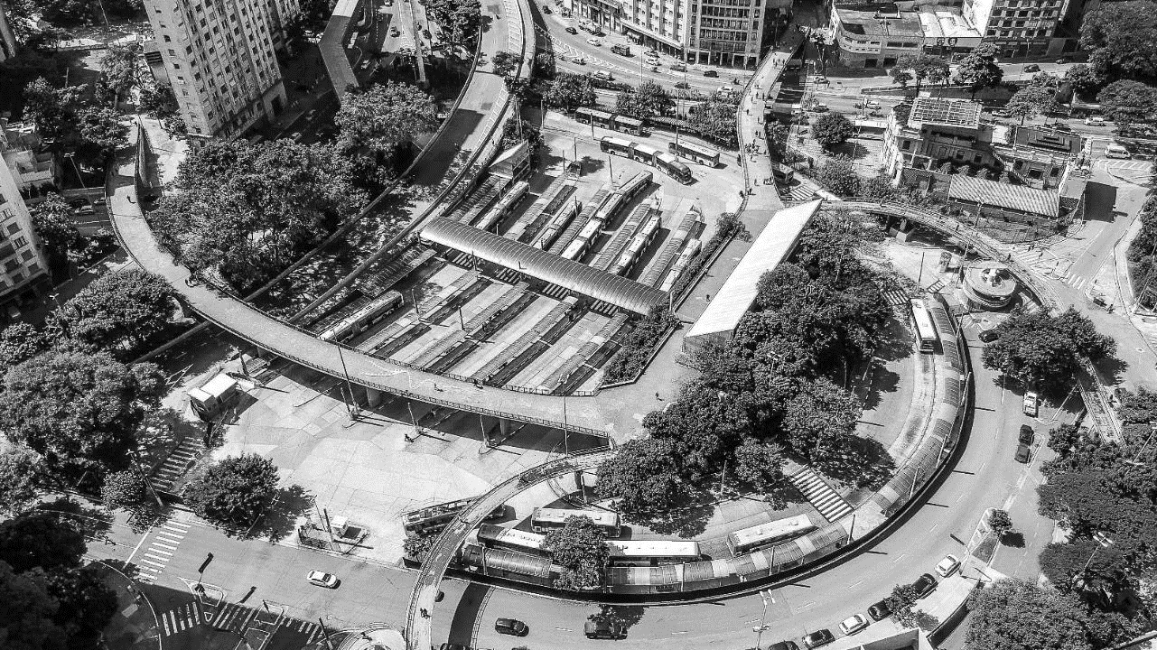
LOW LIGHT IMAGE ENHANCEMENT
DIGITAL IMAGE PROCESSING
Notes:
<a href="https://www.freepik.com/free-photos-vectors/background">Background vector created by freepik - www.freepik.com</a>

Slide 2

TEAM MATES
SATHIYAMATHI V
20MIS1159
NITHISH KUMAR A N
20MIS1091
EYOHESHWARAN V
20MIS1030
Notes:
Photo by sergio souza on Unsplash
<a href="https://www.freepik.com/free-photos-vectors/business">Business vector created by katemangostar - www.freepik.com</a>

Slide 3
INTRODUCTION :
Low light image enhancement is an active area of research that enables the acquisition system to capture superior quality images even under low-light conditions. Its applications include autonomous driving, photography, military, object detection, and surveillance. Low-light image enhancement (LIE) algorithms consider several factors like color contrast, brightness, image resolution, and dynamic range. Several researchers use image processing techniques to enhance low-light images, such as histogram equalization (HE) [1] that tend to equalize the dynamic range of intensities.
Notes:
<a href="https://www.freepik.com/free-photos-vectors/background">Background vector created by freepik - www.freepik.com</a>

Slide 4
INTRODUCTION :
Spatial filters and other image processing techniques have shown improvement in the low-lit image quality, but these methods fail to work under noisy context. Noise, typically, is amplified by the filters, as they rely on a small neighborhood. These reasons justify the need for deep-learning in enhancing low-light images, as these methods can dynamically learn and handle noisy as well as clean images.
Notes:
<a href="https://www.freepik.com/free-photos-vectors/background">Background vector created by freepik - www.freepik.com</a>

Slide 5
LITERATURE
Kaiming He et al. presents Deep Residual Learning technique for training deeper neural networks. Generally deeper neural networks are more difficult to train. Proposed solution presents a residual learning framework to ease the training of networks that substantially deeper than those used previously. In deeper network a vanishing/exploding gradient problem hamper convergence of network from beginning. This problem however has been largely addressed by normalized initialization and intermediate normalization layers which enable networks to start converge, but again when deeper network starts converging, a degradation problem has been exposed: with the network depth increasing accuracy get saturated and then degrades rapidly. The degradation problem can be mitigated using deep residual learning framework. In which shortcut connections are there which skip one or more layers. This neither add extra parameter nor computational complexity. The deep network will be able to train end -to -end by SGD with backpropagation without degradation and vanishing/exploding gradient problems. Authors were able to train networks with depths of 18, 34, 50, 101, 152 with no saturation and giving better results as compared to plain networks of similar depth.[2]

Slide 6
LITERATURE
Gao Huang et al. presents Dense Convolution Network (DenseNet), which connects each layer to every other layer in a feed -forward fashion. While tradition convolution networks with L layers have L connection, proposed network has L (L + 1) / 2 direct connection. For each layer, the feature maps of a ll preceding layers are used as inputs, and its own feature-maps are used as inputs into all subsequent layers. DenseNet have several compelling advantages: they alleviate the vanishing gradient problem, strengthened feature propagation, encourage feature reuse and substantially reduce the number of parameters. DenseNet obtain significant improvements over the state -of-the-art on most of them, whilst requiring less computation to achieve high performance.[3]

Slide 7
LITERATURE
Bee Lim et al. presents enhanced deep super-resolution network (EDSR). There is significant performance improvement of the model due to optimization by removing unnecessary modules in conventional residual networks. The performance is further improved by expanding the model size while stabilizing the t raining procedure. The proposed model removes batch normalization layers because they create blurry results and also increase GPU memory usage also activation function outside residual block has been removed. With this saved memory a larger network, can be build. It is also observed that after a certain number of feature maps training procedure become numerically unstable. To mitigate this issue residual scaling with a factor of 0.1 has been adopted. Constant scaling layers are placed after the last coevolution layers. These modules stabilize the training procedure greatly when us ing a large number of filters.[4]

Slide 8
METHODOLOGIES
MIRNet Model
Here are the main features of the MIRNet model:
A feature extraction model that computes a complementary set of features across multiple spatial scales, while maintaining the original high-resolution features to preserve precise spatial details.
A regularly repeated mechanism for information exchange, where the features across multi-resolution branches are progressively fused together for improved representation learning.
A new approach to fuse multi-scale features using a selective kernel network that dynamically combines variable receptive fields and faithfully preserves the original feature information at each spatial resolution.
A recursive residual design that progressively breaks down the input signal in order to simplify the overall learning process, and allows the construction of very deep networks.

Slide 9
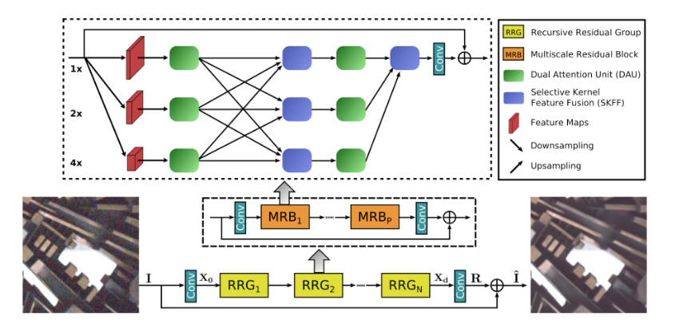
METHODOLOGIES

Slide 10
REQUIREMENTS
HARDWARE REQUIREMENTS
SOFTWARE REQUIREMENTS
Processor - 1GHz and above
RAM - 512 MB and above
Memory – 4 GB and above
Operating system :Windows 7 Ultimate and above
• Coding Language : PYTHON
• Front-End : PYTHON
• Data Base : KAGGLE
• Software : KAGGLE

Slide 11
DATASETS
Collecting natural low-light scenes along with their corresponding normal/bright image pair is a challenging task. Several authors collected a set of raw images to generate a synthetic dataset [13]–[15], [22]. However, most of these datasets consider images taken in a carefully monitored environment, and therefore they do not ideally represent the natural scene. Moreover, it is challenging to generate a synthetic dataset as there is no consensus over the low-light image generation method. Some works have used software like Adobe Photoshop Lightroom [14], while others have devised more elaborate image selection and transformation techniques [15]. We utilized the MIT outdoor and indoor scenes dataset [31] to generate synthetic, low-light images. Gamma correction, used in [13], is incorporated to simulate low illumination effects. We have used 5000 images from the MIT dataset to generate a low-light image dataset (LID). LID comprises both clean and noisy images to simulate real-world scenarios. We have used 4500 and 500 image pairs for training and testing, respectively

Slide 12
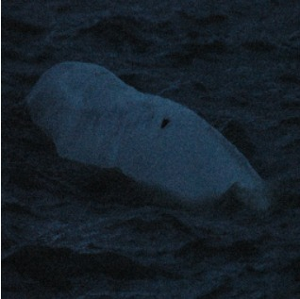
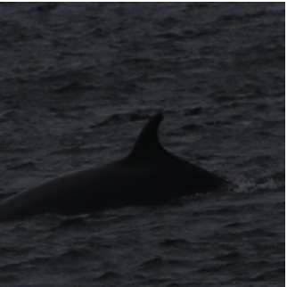
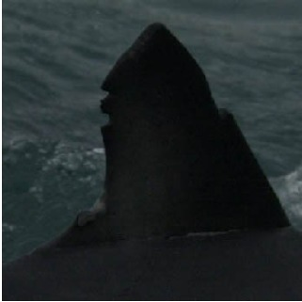
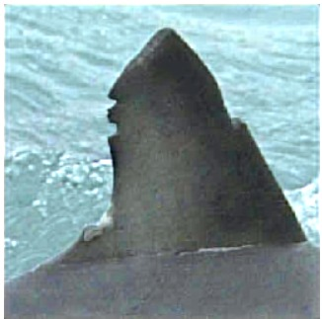
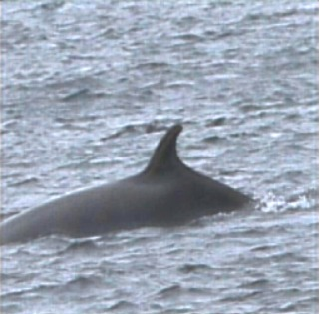
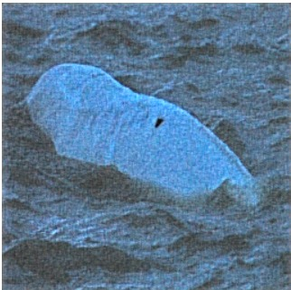
RESULT

Slide 13
RESULT
In the previous slide, the images in the 1st row are the input images and the images in the 2nd row are the images same as the 1st row which are enhanced after the implementation

Slide 14
CONCLUSION
Edges of the images have been successfully detected by subtracting its blurred image by using unsharp mask filter. Graphical representation has been obtained which contains stretched range of intensities of pixels. And enhanced image has been obtained through contrast enhancement using keras and mirnet
The used algorithm for denoising image is not optimized. Advanced, more efficient and optimized algorithms like Gaussian filtering, an improved Non-Local Means of denoising algorithm, etc. are available. Algorithm for appending could also be optimized using advanced concepts. Histogram equalization algorithm could be improved by replacing it with more advanced technique known as Adaptive Histogram Equalization technique.

Slide 15
REFERENCES
Low Light Image Enhancement in Python & Keras | Pixel-like NightMode using Deep Learning - Tutorial
[https://huggingface.co/keras-io/lowlight-enhance-mirnet](MIRnet on Hugging Face)
Mirnet Keras Documentation
[1]. Kaiming He, Xiangyu Zhang, Shaoqing Ren and Jian Sun, “Deep Residual Learning for Image Recognition” 2015
[2]. Gao Huang, Zhuang Liu, Laurens van der Maaten and Kilian Q. Weinberger, “Densely Connected Convolutional Networks” 2018
[3]. Bee Lim, Sanghyun Son, Heewon Kim, Seung jun Nah and Kyoung Mu Lee, “Enhanced Deep Residual Networks for Single Image Super-Resolution” 2017
[4]. Chao Dong, Chen Change Loy, Kaiming He and Xiaoou Tang, “Image Super-Resolution Using Deep Convolutional Networks” 2015
[5]. Christian Ledig, Lucas Theis, Ferenc Husź ar, Jose Caballero, Andrew Cunningham, Alejandro Acosta, Andrew Aitken, Alykhan Tejani, Johannes Totz, Zehan Wang and Wenzhe Shi, “Photo -Realistic Single Image Super-Resolution Using a Generative Adversarial Network” 2017
[6]. Yulun Zhang, Yapeng Tian, Yu Kong, Bineng Zhong and Yun Fu, “Residual Dense Network for Image Super Resolution” 2018
[7]. https://medium.com/@jonathan_hui/gan-whats-generative-adversarial -networks -and-its-applicationf39ed278ef09
[8]. https://medium.com/technologymadeeasy/the-best-explanation-of-convolutional-neural-networks-on-the - internet fbb8b1ad5df8
[9]. https://medium.com/beyondminds/an-introduction -to -super-resolution-using-deep-learning -f60aff9a499d

Slide 16
THANK
YOU!
Notes:
<a href="https://www.freepik.com/free-photos-vectors/background">Background vector created by freepik - www.freepik.com</a>

